Slide 1


Slide 2
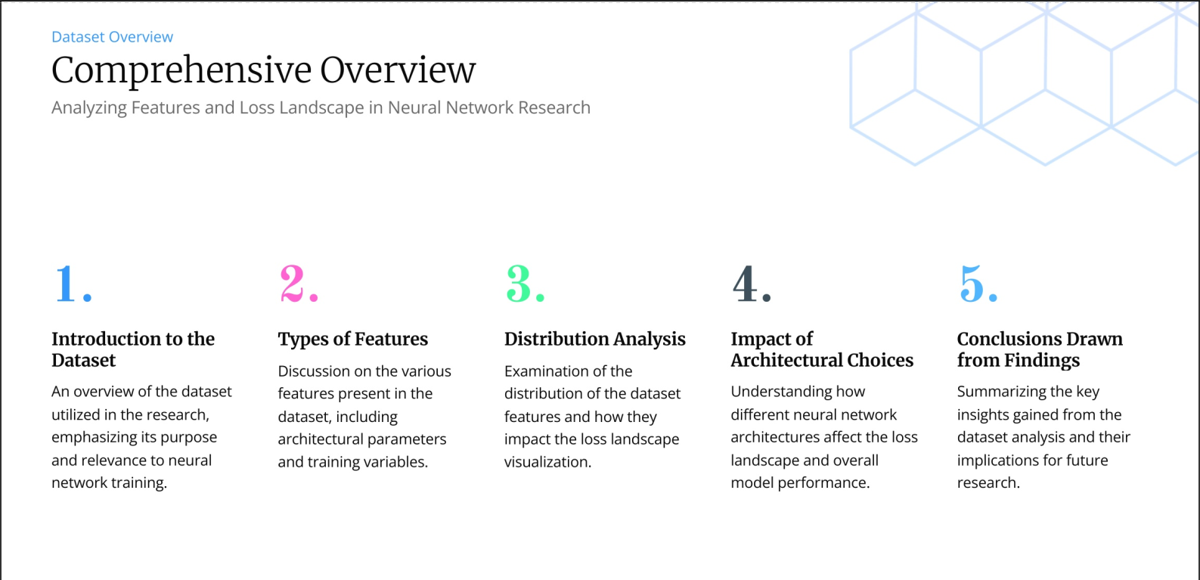
1

Slide 3
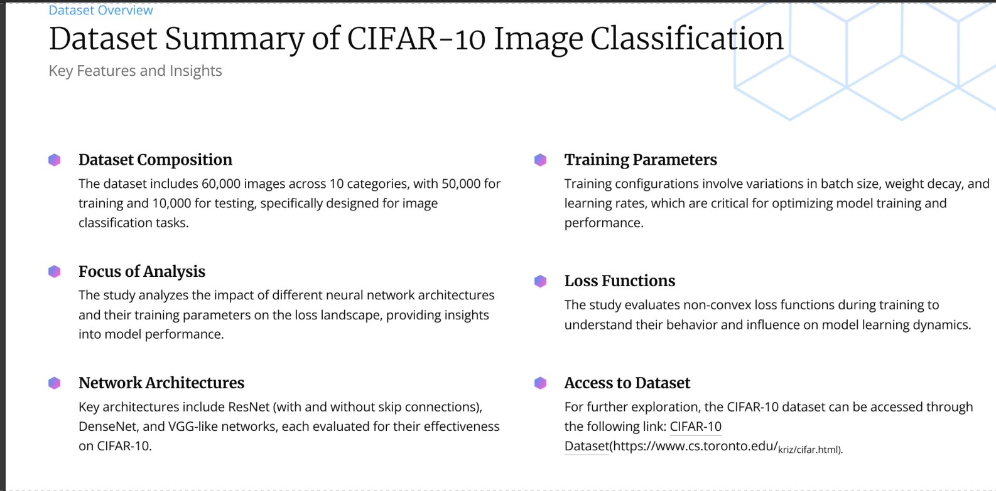
2

Slide 4
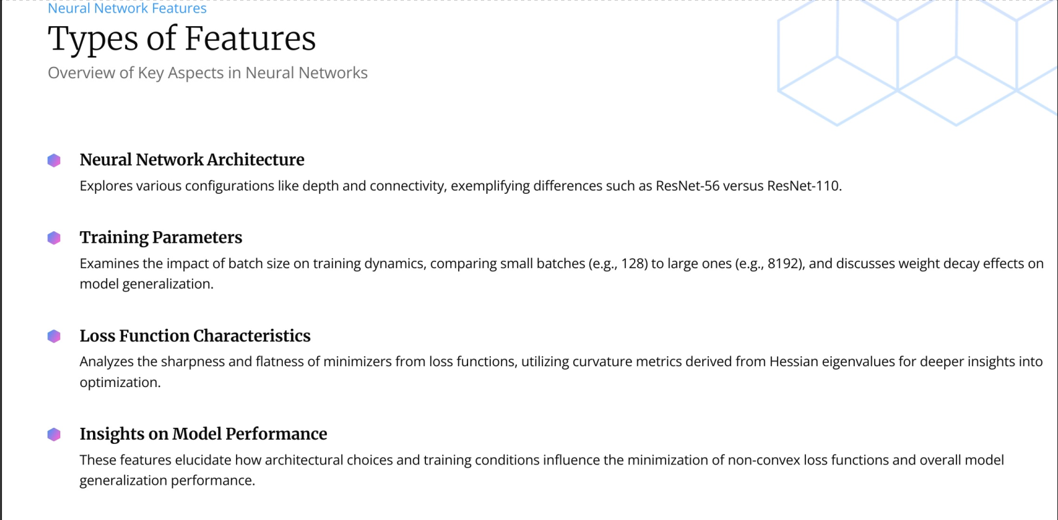
3

Slide 5
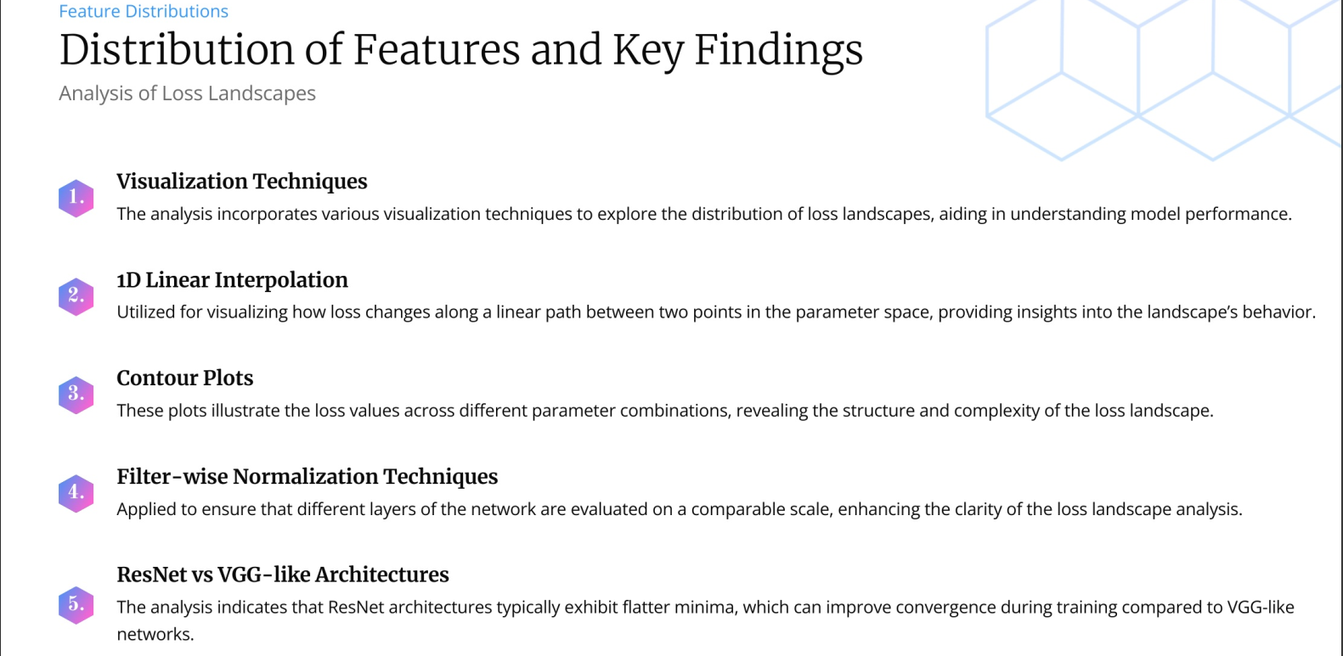
4

Slide 6
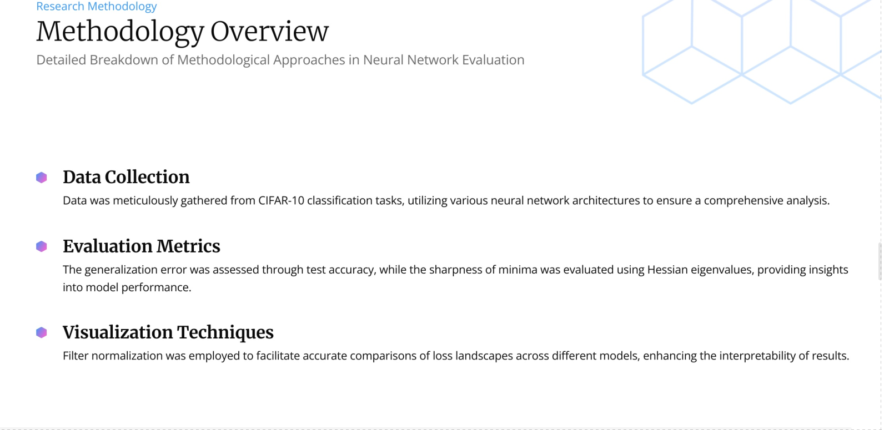
5

Slide 7
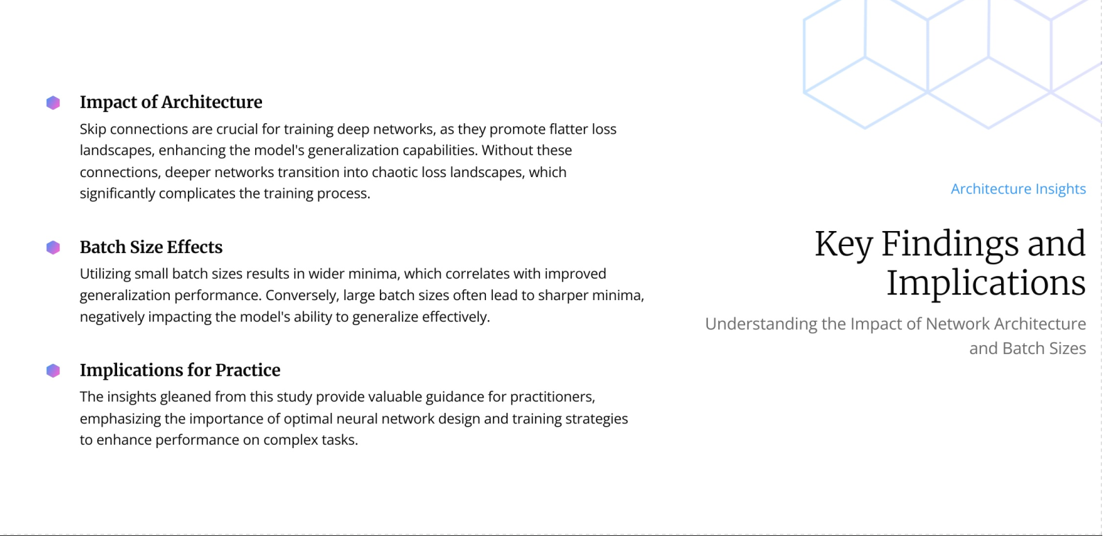
6

Slide 8
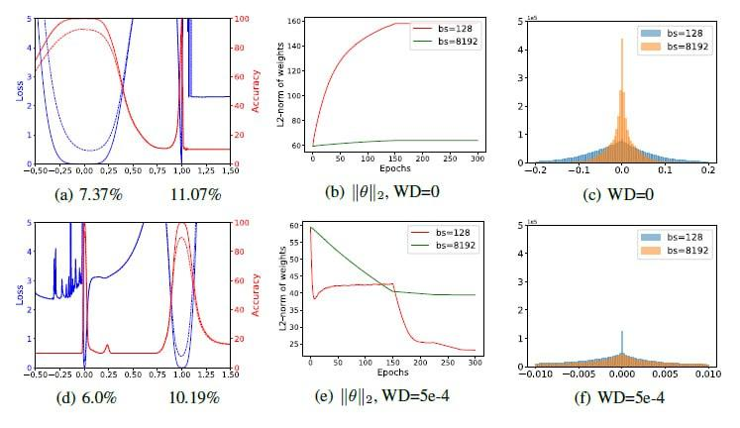
1D Linear Interpolation
Fig. 1
Li et al. (2018)
7
Notes:
1D linear interpolation: Simple, but limited in capturing the complexity.
Figure 1: (a) and (d) are the 1D linear interpolation of VGG-9(visual geometry group) solutions obtained by small-batch and large-batch training methods. The blue lines are loss values and the red lines are accuracies. The solid lines are training curves and the dashed lines are for testing. Small batch is at abscissa 0, and large batch is at abscissa 1. The corresponding test errors are shown below. (b) and (e) shows the change of weights norm fai(symbol) during training. When weight decay is disabled, the weight norm grows steadily during training without constraints (c) and (f) are the weight histograms, which verify that small-batch methods produce more large weights with zero weight decay and more small weights with non-zero weight decay.

Slide 9
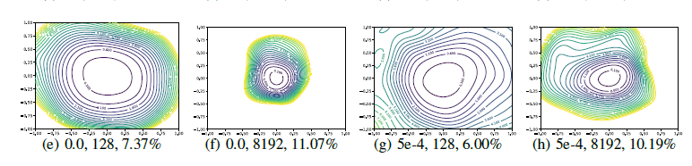
Contour plots
Fig. 1
Fig. 2
Li et al. (2018)
8
Notes:
Contour plots & random directions: Better at showing non-convexity, but still limited and prone to misleading interpretations without normalization.

Slide 10
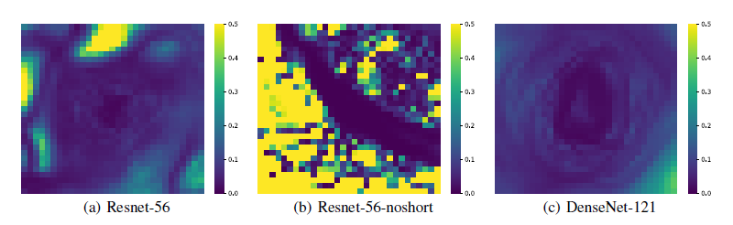
Filter-wise normalization
Fig. 3
Li et al. (2018)
9
Notes:
Filter-wise normalization: The authors’ proposed method to address the scale-invariance issues in visualizing network weights

Slide 11
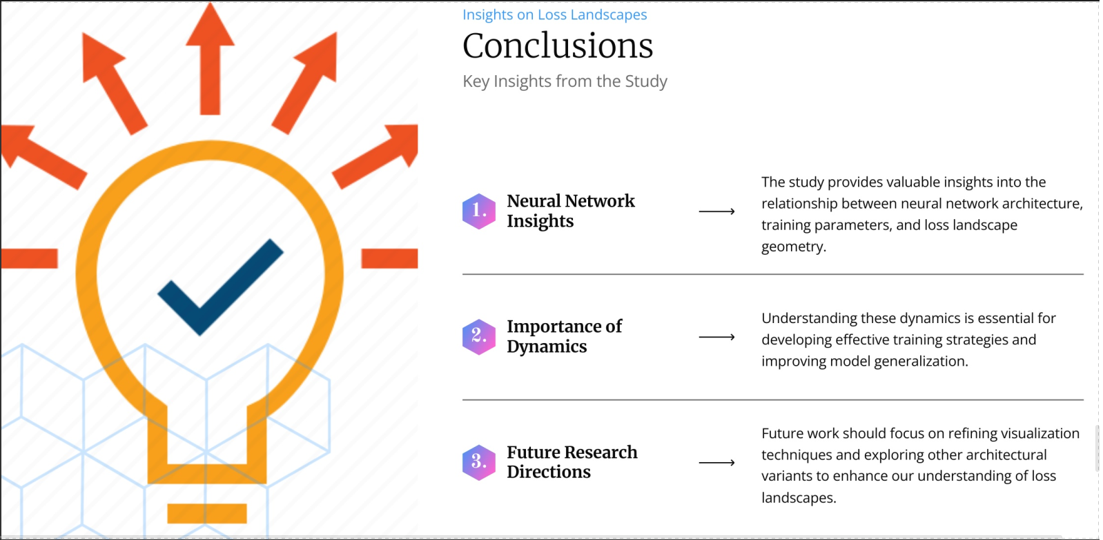
10
Notes:
This research provides compelling evidence that the geometry of the loss landscape significantly affects the trainability and generalization ability of neural networks. The use of skip connections and wider networks appears to be crucial for creating more benign, convex-like loss landscapes, making training easier and resulting in models that generalize better. However, further research is needed to fully understand the complex interplay between loss function geometry, optimization algorithms, and generalization performance. The authors’ findings challenge existing assumptions and offer a new perspective on fundamental questions in deep learning.

Slide 12
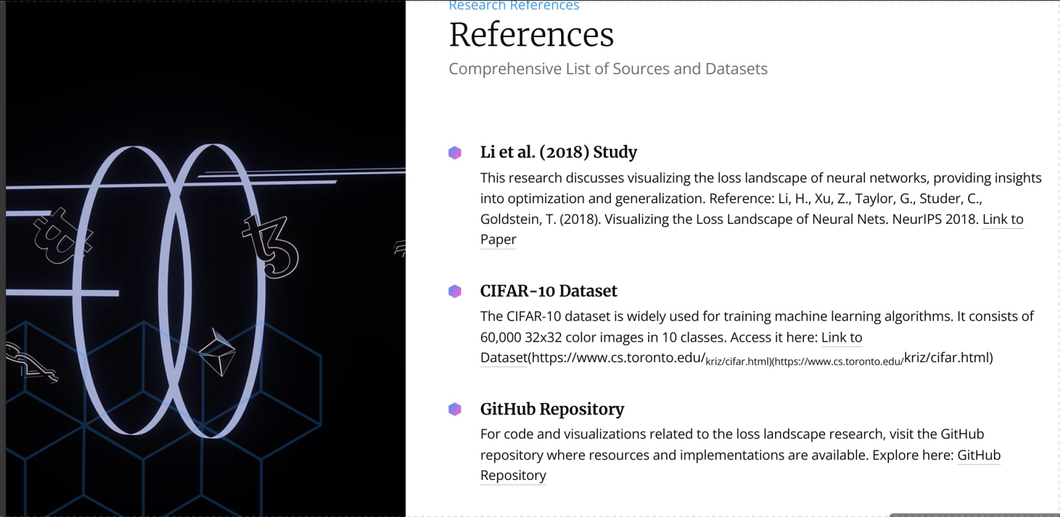
11

